Slide 1
Novel approaches for visualizing time to event data
Presenter: Victor Pacifique Rwandarwacu
Supervisor: Prof. John Newell

Slide 2
PRESENTATION OUTLINE
Background
Definition +rationale
Problem statement
Overview: (Survival function, Mean Residual Life (MRL) function )
Dataset
Method
Online Survey: clinicians’ knowledge and perspectives on survival data visualization.
Result
Discussion
Strength
Limitations
Conclusion

Slide 3
BACKGROUND
Time-to-event or survival Analysis is the analysis of data in the form of times from a well-defined time origin until the occurrence of an event of interest(Collett, 2023).
Survival data are generally asymmetric and censored, requiring a specific approach to analysis and visualization
e.g, Survival and Hazard function, KM estimator & plot, etc.
Survival analysis has many applications in clinical practice, ie. time to recurrence, time to remission
The survival function is the probability that the survival time is greater than or equal to a time (t), which is the observed value of a random variable (T) with distribution F(t) (Peace, 2009)
Survival ratio and difference are used to estimate relative and absolute difference respectively (Newell et al., 2006)
Collett, D. (2023). Modelling Survival Data in Medical Research. Taylor & Francis.
Peace, K. E. (2009). Design and Analysis of Clinical Trials with Time-to-Event Endpoints. CRC Press.
Newell, J., Kay, J. W., & Aitchison, T. C. (2006). Survival ratio plots with permutation envelopes in survival data problems.

Slide 4
Problem statement
Clinicians face challenges including:
understanding standard survival visualizations on probability scales, such as the KM and survival difference plot.
Translation of survival outcome to patients.
The Mean residual Life function is an alternative approach for translating survival outcomes to patients.
The mean residual life function provides a clear and simple summary of the effect of a treatment or a risk factor in units of time, avoiding hazard ratios or probability scales, which require careful interpretation. (Alvarez-Iglesias et al., 2015).
There was no clinical perspective regarding survival versus MRL function
Alvarez-Iglesias, A., Newell, J., Scarrott, C., & Hinde, J. (2015). Summarising censored survival data using the mean residual life function. Statistics in Medicine, 34(11), 1965–1976.

Slide 5
OBJECTIVE + DATASET
Explore time-to-event visualization: survival versus MRL function
Kaplan-Meier Plot
Survival difference Plot
Mean Residual Life (MRL)plot
Mean Residual Life (MRL) difference plot
Assess knowledge and preference of medical doctors and students on time to event data visualization →online survey
Dataset
Open Access
NIH National Cancer Institute, TCGA Program on a project called “Breast invasive carcinoma (BRCA)”.

Slide 6
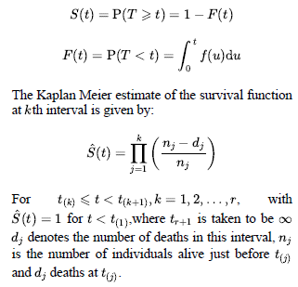
SURVIVAL FUNCTION
Greenwood’s formula. (to be added )
Survival difference → standard error estimation
Notes:
Explain step function nature of KM
Greenwood’s formula.

Slide 7
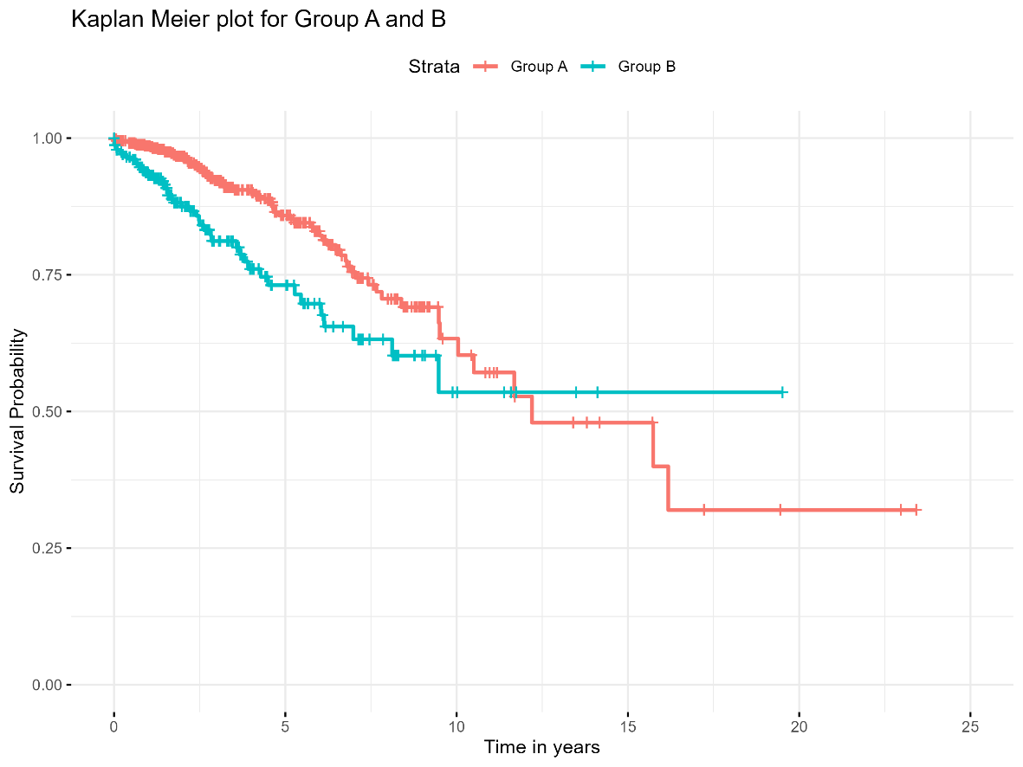
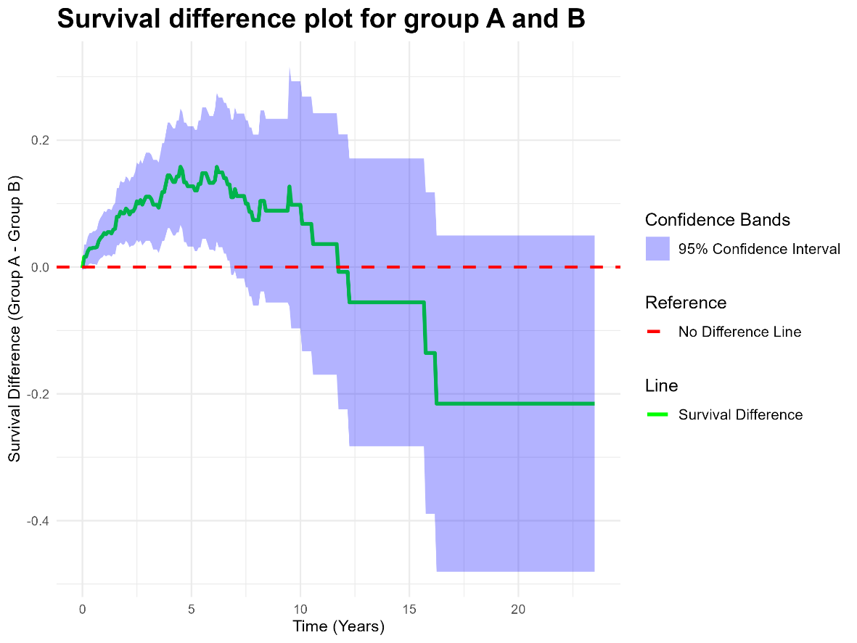
KM AND SURVIVAL DIFFERENCE PLOTS

Slide 8
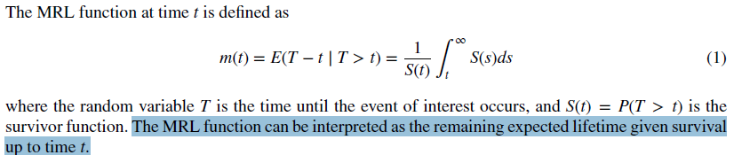
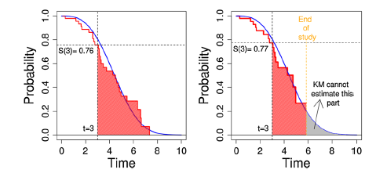
Mean Residual Life (MRL) Function
Alvarez-Iglesias, A., Newell, J., Scarrott, C., & Hinde, J. (2015). Summarising censored survival data using the mean residual life function. Statistics in Medicine, 34(11), 1965–1976.
Notes:
GPD
Extreme value Theory

Slide 9
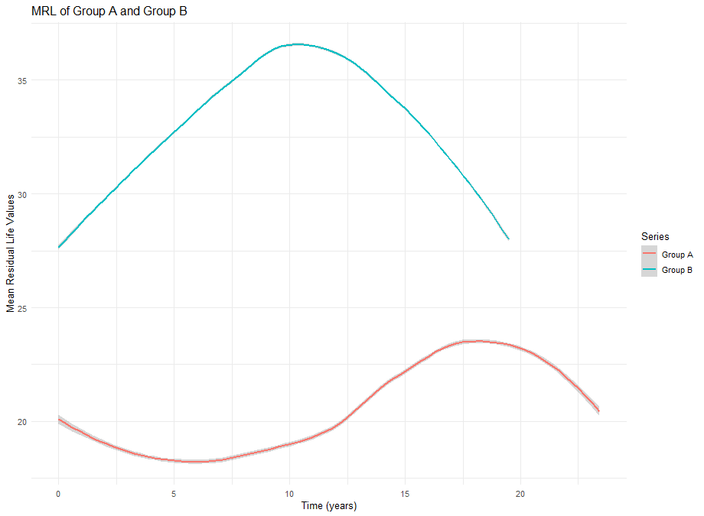
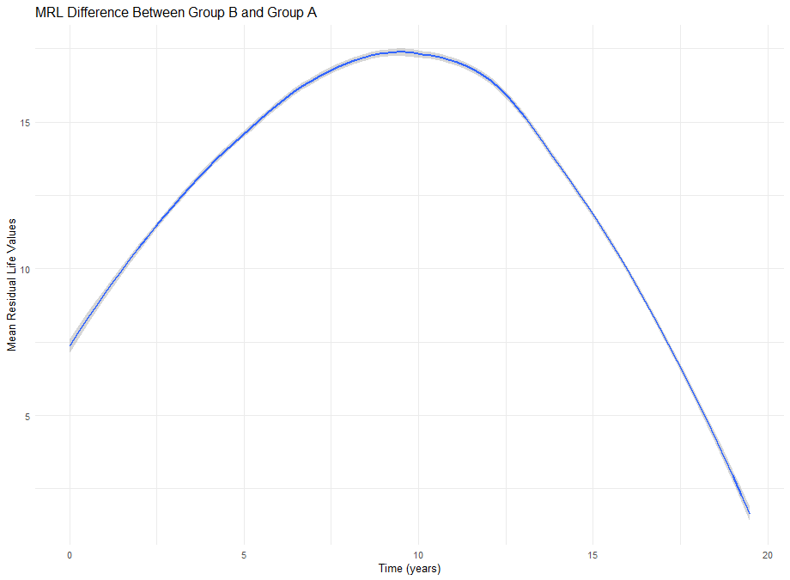
MRL &MRL difference plot

Slide 10
Survey: clinicians’ perspectives on survival data visualization

Slide 11
SURVEY DESCRIPTION
Target population: Medical Students & Doctors
Data collection: anonymous online survey (Google form)
Convenience sampling (Voluntary, no randomization)
No ethical approval required
Data collection Period: 15th April - 20th May 2025 (5 weeks)
Outcome :
Proportion of correct interpretation before and after the provision of the correct interpretations
preferences across KM, survival difference, MRL, and MRL difference plot for clinicians’ understanding and patients’ communication.

Slide 12
QUESTIONNAIRE STRUCTURE
Demographic information (Country and Qualification)
Self-rated knowledge on survival analysis (1 to 10 scale)
Four plots for interpretation (Pre-assessment)
Provision of correct interpretations for the pre-assessment (learning section)
New plots for interpretation(Post- assessment)
Ranking 1: plot easy to understand by clinician (easy to hard)
Ranking 2: plot that clinician prefer to use in consultation with the patient(easy to hard)

Slide 13
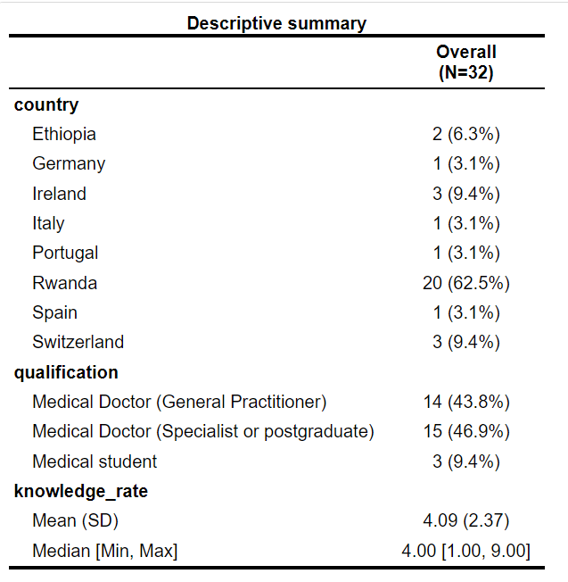
Demography & Result 1
38 responses received
In total, 32 responses were analyzed
75% of respondents rate themselves 5 and below.
Data analysis (NVivo and R)

Slide 14
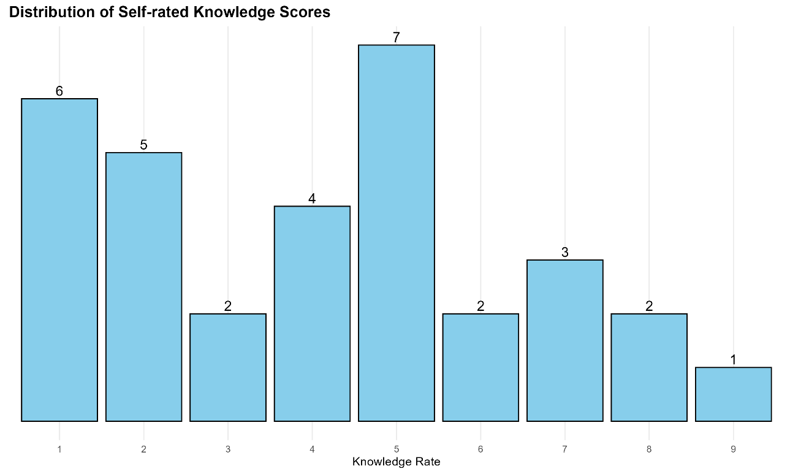
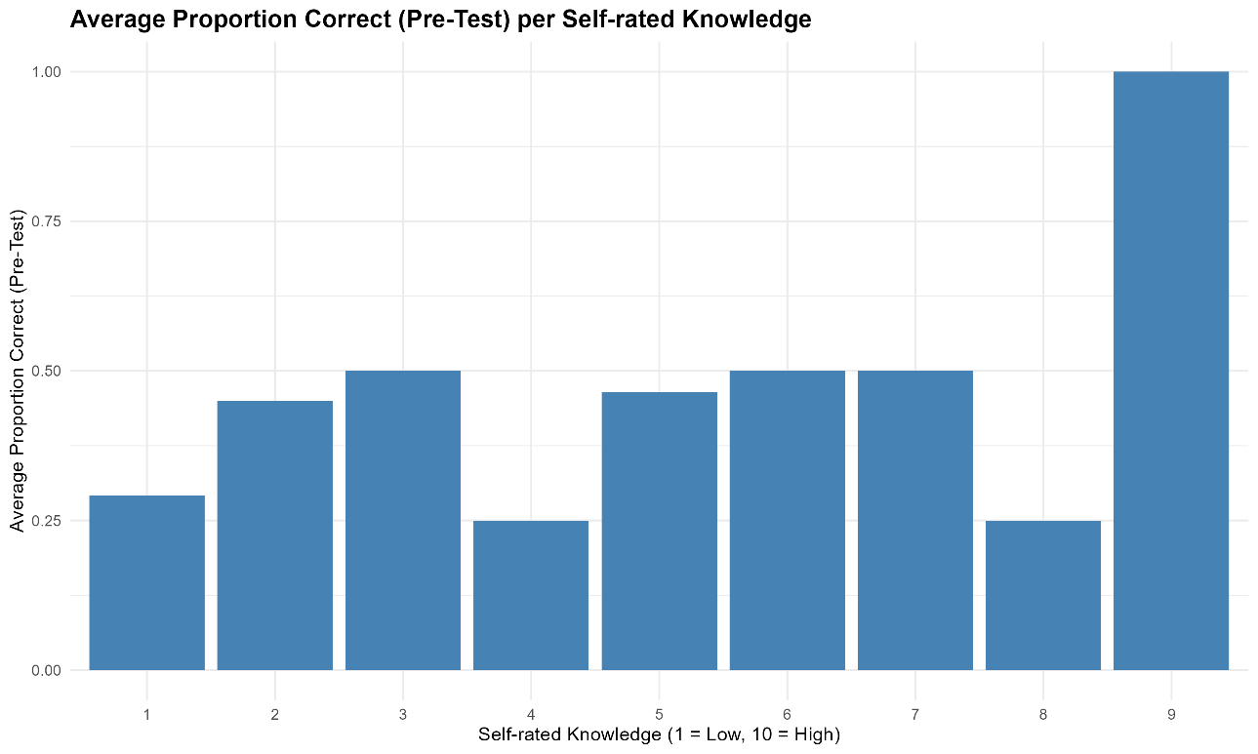
Do those who say they know actually know?
Notes:
Rates 5 and 1 were the most prevalent, with frequencies of 7 and 6 respectively
Do those who say they know actually know?

Slide 15
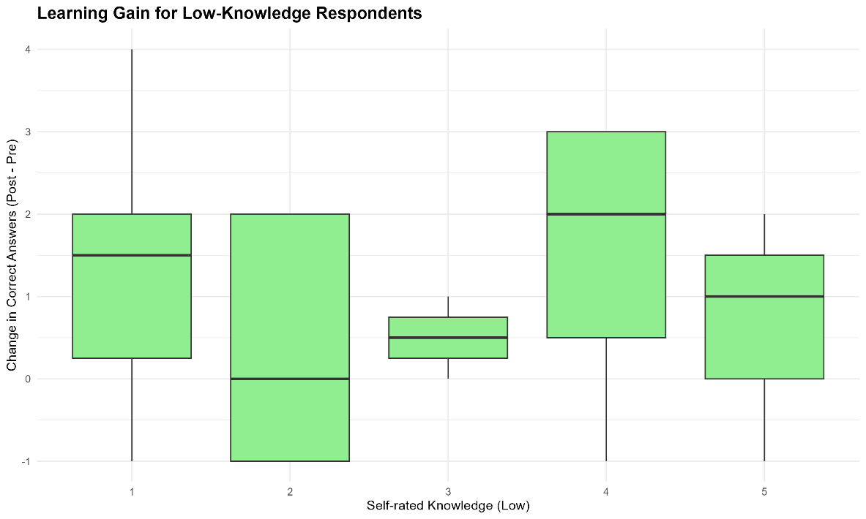
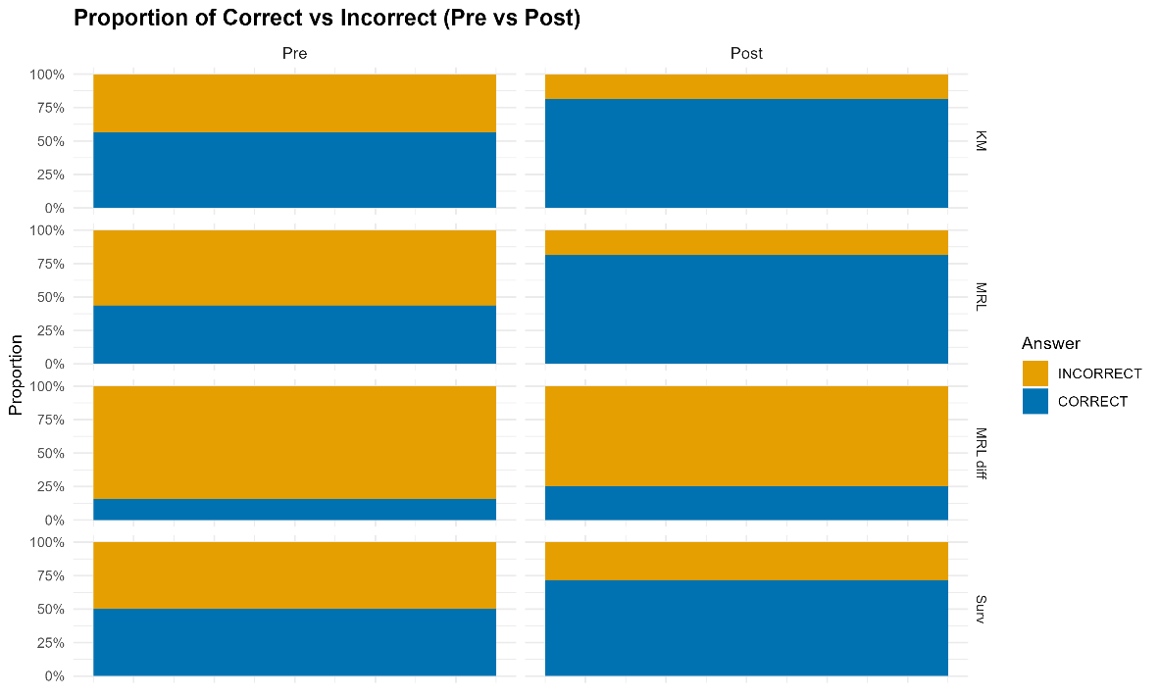
Knowledge Gain
Notes:
There was more improvement on the Mean residual Life plot (Pre versus post)-→ New knowledge and easy to grasp
Overall learning effect was positive for those with lower self-rated knowledge.

Slide 16
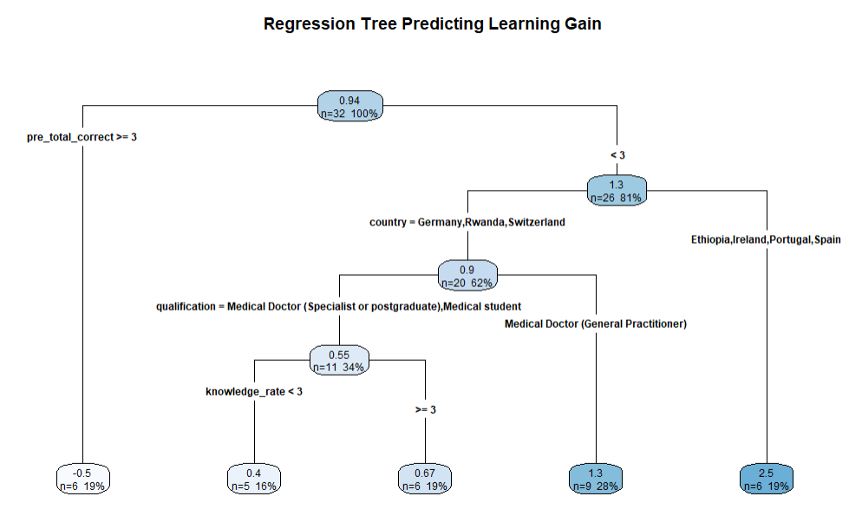
Knowledge Gain - Regression Tree
Notes:
There was no knowledge gain for clinicians who scored above 50% in pretest
There was country variations and qualification
Self-rated knowledge positive but minimal effect on knowledge gain.

Slide 17
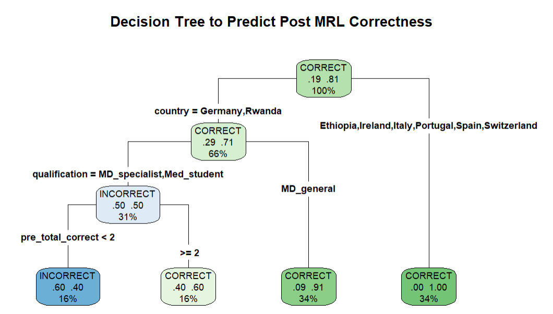
Prediction of Post MRL correctness
Notes:
There was a noticeable increase in the accuracy of interpretation for MRL.
The correct interpretations were more from general practitioner from Ethiopia,Ireland,Portugal,spain and Switzerland.

Slide 18
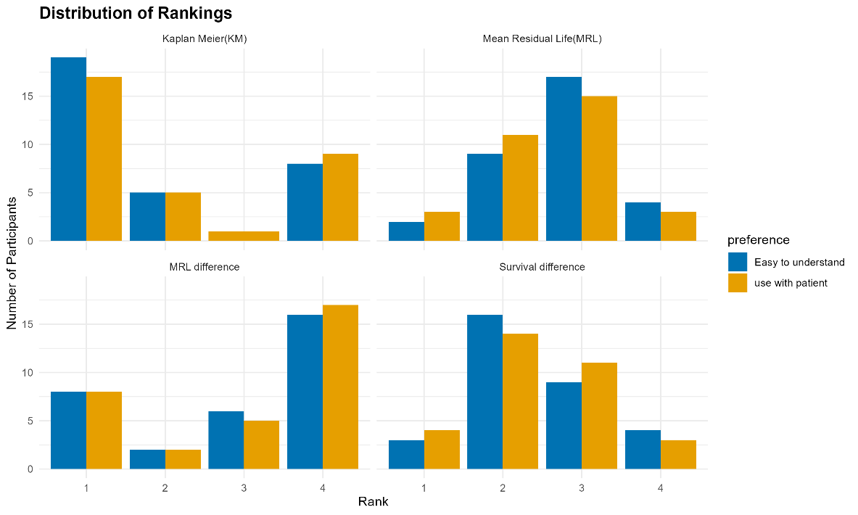
Ranking distribution
Kaplan-Meier is the most preferred plot, followed by: Survival difference, MRL plot, and MRL difference plot, respectively.

Slide 19
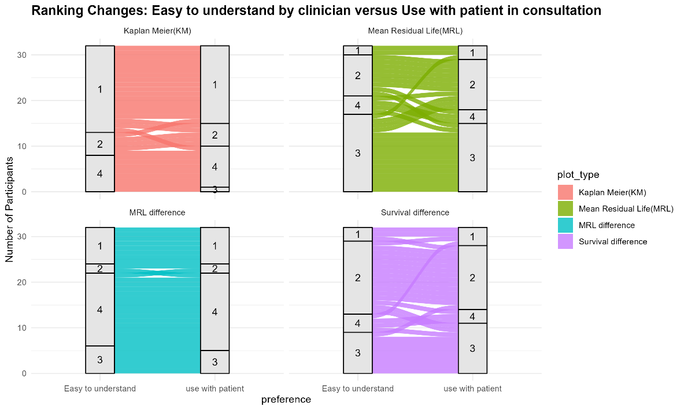
Ranking changes
The ranking change was the highest for the MRL plot.

Slide 20
STRENGTH & LIMITATIONS
Strength
Novel
mixed-method research
Primary insight from individual clinicians
Limitation
Convenience study & uncontrolled setting ( risk of bias )
Short data collection period

Slide 21
CONCLUSION
There is limited knowledge in survival plot interpretation among medical doctors and students.
The respondents are familiar with Kaplan Meier compared to other presented graphs.
MRL function is a new concept for clinicians
MRL plot has the highest improvement in accuracy of interpretations -→ thus, it’s easy to learn and apply.
WAY FORWARD:
Collect more insight from clinicians (extend timeline)

Slide 22
REFERENCES
Alvarez-Iglesias, A., Newell, J., Scarrott, C., & Hinde, J. (2015). Summarising censored survival data using the mean residual life function. Statistics in Medicine, 34(11), 1965–1976.
https://doi.org/10.1002/sim.6431
Collett, D. (2023). Modelling Survival Data in Medical Research. Taylor & Francis. https://books.google.ie/books?id=rIp0zwEACAAJ
Peace, K. E. (2009). Design and Analysis of Clinical Trials with Time-to-Event Endpoints. CRC Press. https://books.google.ie/books?id=3f_LBQAAQBAJ
Portal.gdc.cancer.gov/projects/TCGA-BRCA. (n.d.). Retrieved May 26, 2025,
https://portal.gdc.cancer.gov/projects/TCGA-BRCA
Newell, J., Kay, J. W., & Aitchison, T. C. (2006). Survival ratio plots with permutation envelopes in survival data problems. Computers in Biology and Medicine, 36(5), 526–541.
https://doi.org/10.1016/j.compbiomed.2005.03.005

Slide 23
THANK YOU!

Slide 24
ANNEX
These slides will be used during Q&A

Slide 25
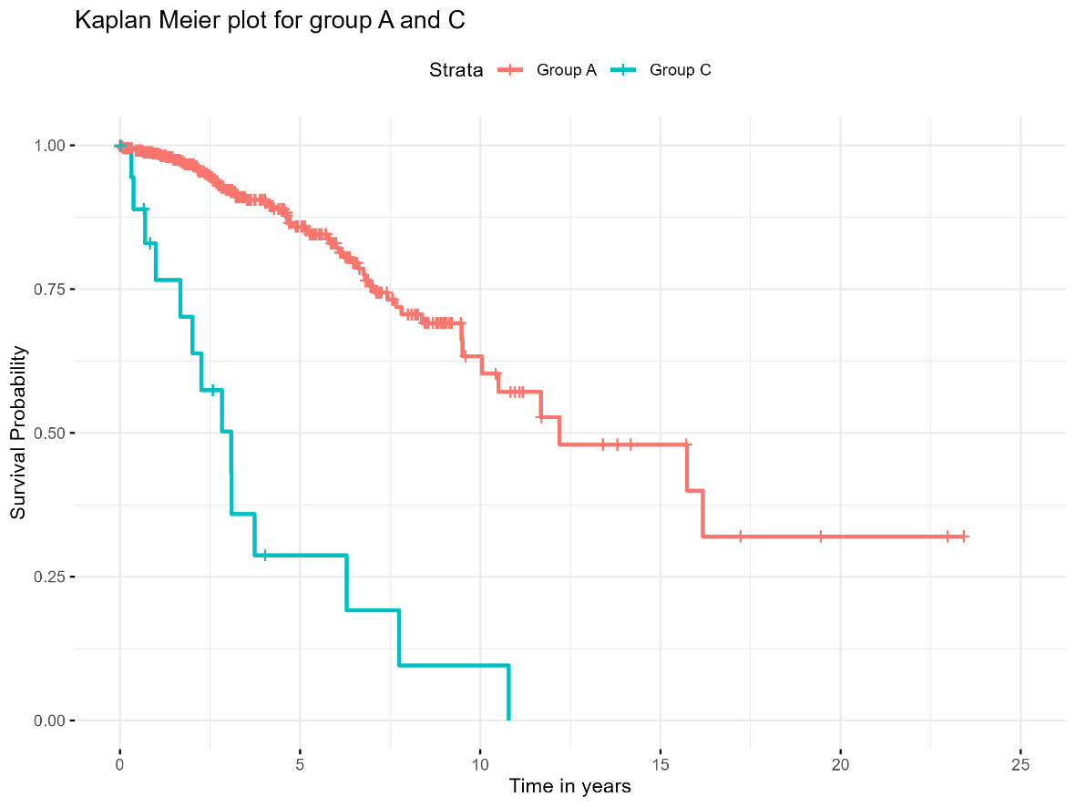
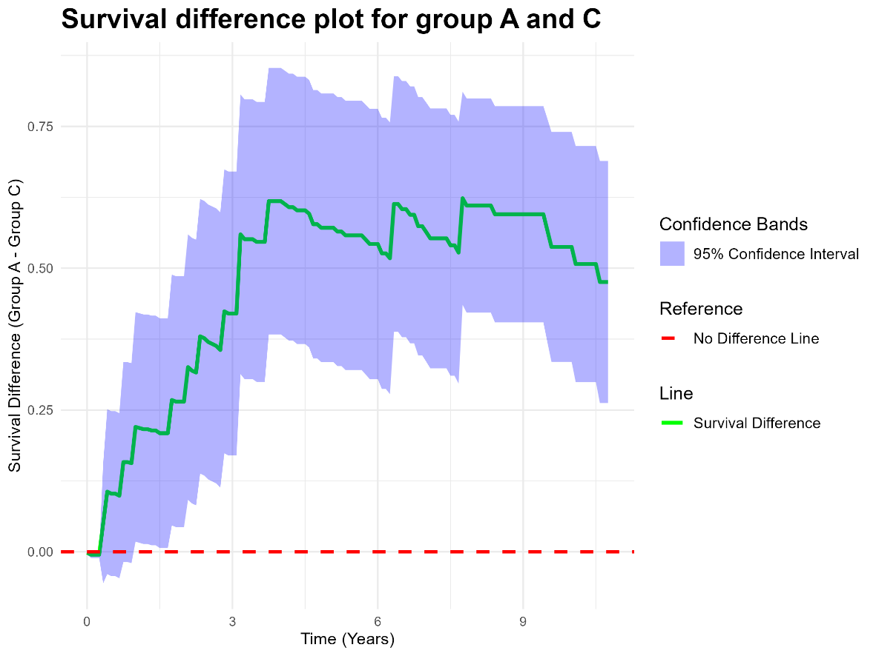
POST: Survival function plots

Slide 26
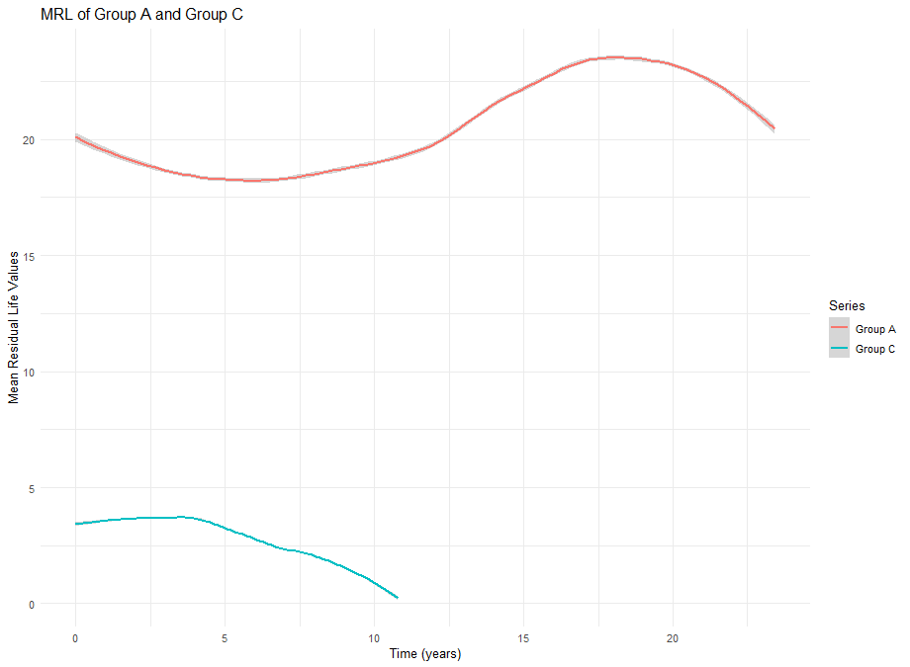
POST= MRL PLOTS

